Slide 1
Google Play Store Analysis
By: Mayank Goswami

Slide 2
Contents
Objective
Data Explanation
Data Preprocessing
Classification Models
Evaluation and Validation
Conclusion
ANOVA

Slide 3
Objective And Motivation
Google Play Store is the most popular application store worldwide with more than 2.8 Million applications and thousands of new
applications being added daily.
There’s a pretty good chance of your brilliant new app idea has
already been taken, but it shouldn’t discourage you. Facebook came after Myspace. The more important thing is how to know that your application idea could be popular among users.
Answers to this question can be given by gaining the knowledge from the existing applications on the application play store.
This can in return help to make predictions for making important decisions for application developers like which category of application attracts more users along.

Slide 4

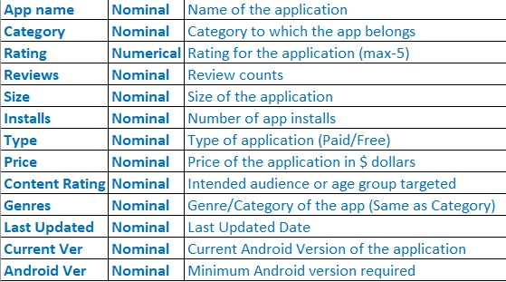
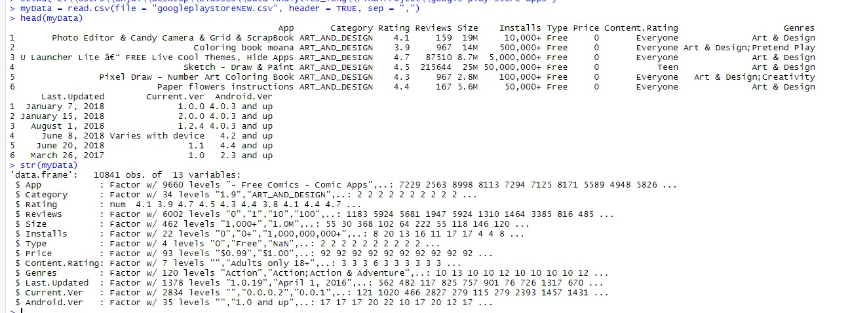
Data Explanation
The dataset used here is taken from Kaggle which has 10841 observations of 13 variables
https://www.kaggle.com/lava18/google-play-store-apps

Slide 5
Data Preprocessing

Slide 6
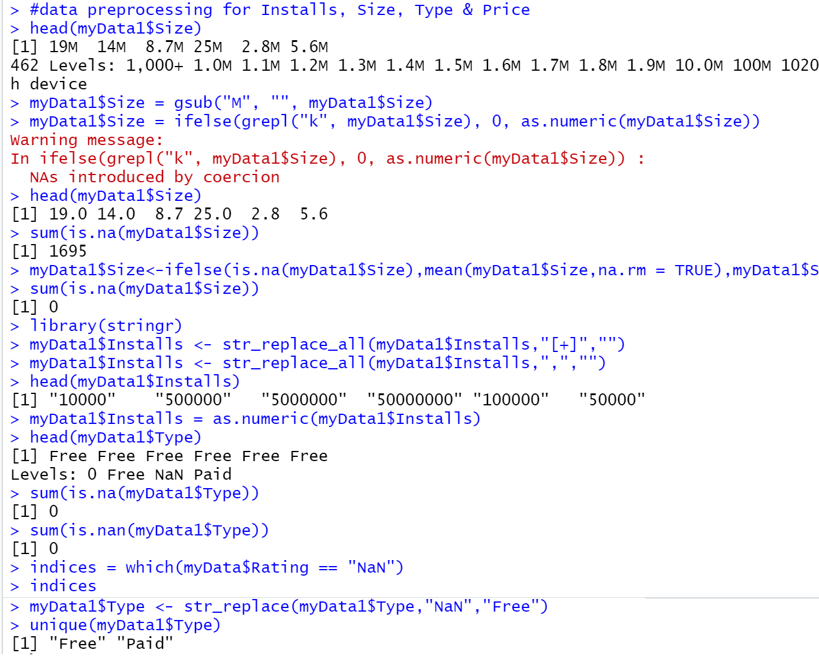
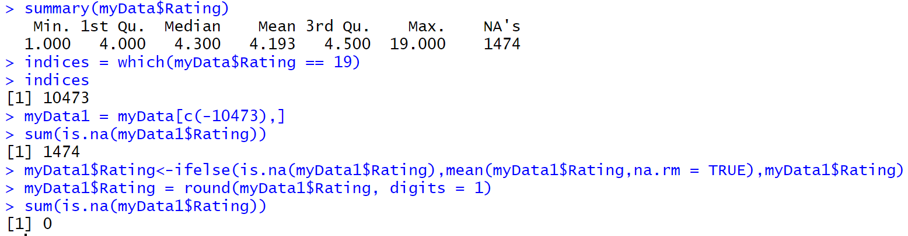
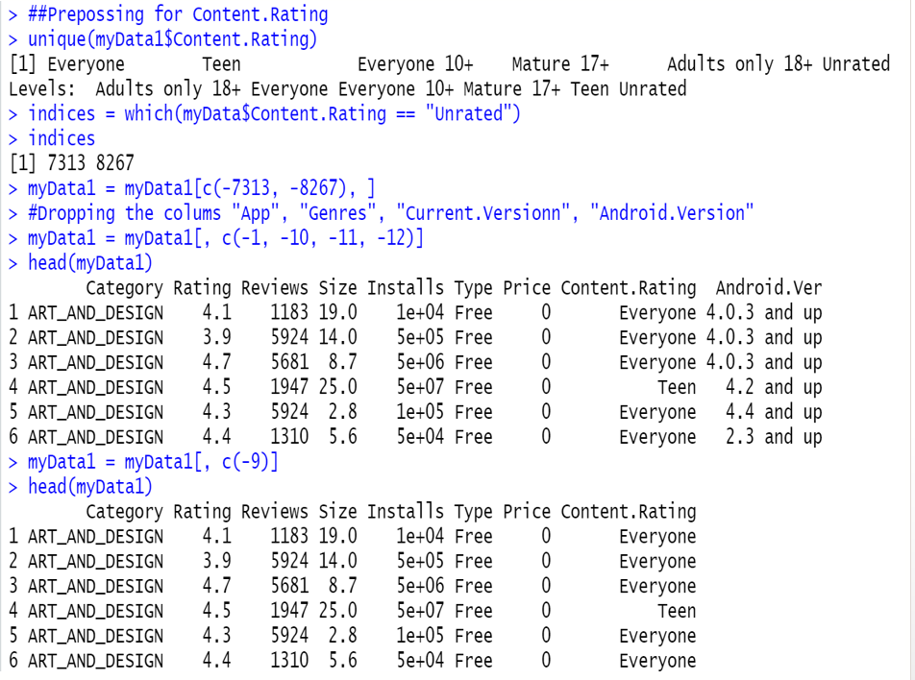
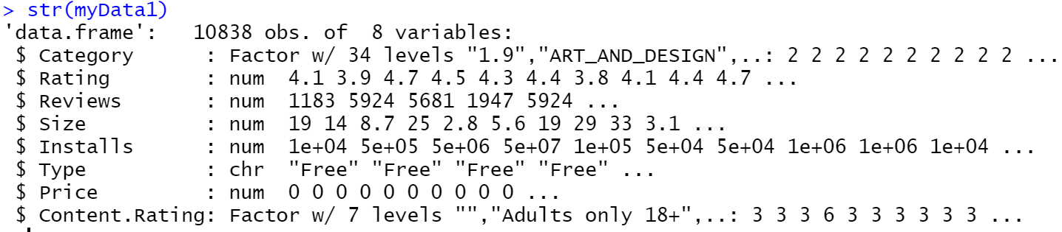
Data Preprocessing: Replacing missing values and Conversion of Dependent variable

Slide 7
ANOVA

Slide 8
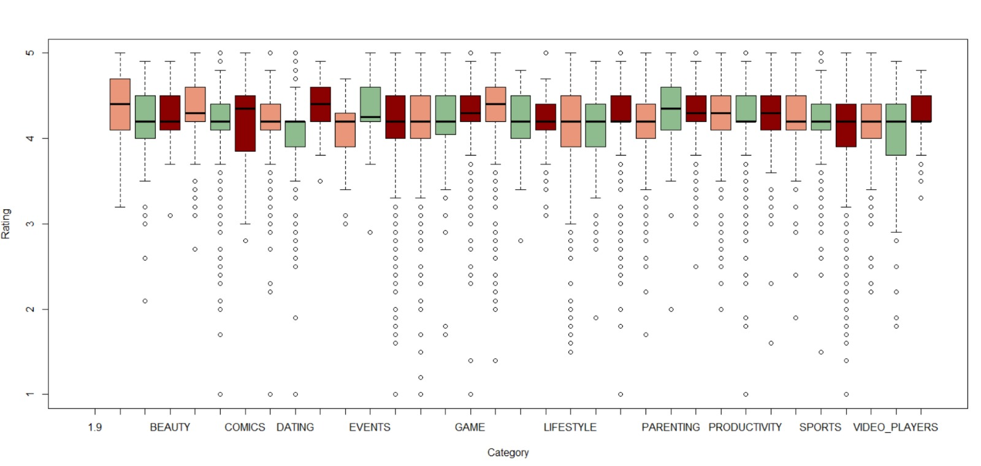
BOXPLOT

Slide 9
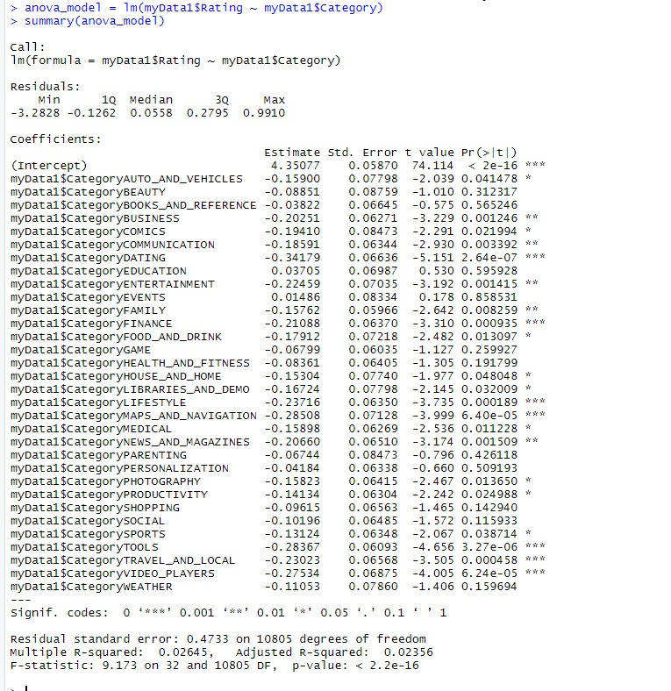

Anova
Null Hypothesis: $H_{0}$= Average mean value of Rating corresponding to all Categories are equal. $µ_{category_dating} = µ_{category_tools} = µ_{category_personalization} = µ_{category_education} = ......................................... = µ_{category_lifestyle}$
Alternate Hypothesis: $H_{a}: µ_{i} ≠ 0$ which means at least there will be one category which do not have average mean rating not equal to some other category.
Alpha = 0.05

Slide 10
Classification Models
Building the classification models to predict the Rating: -
KNN Classification
Logistic Regression

Slide 11
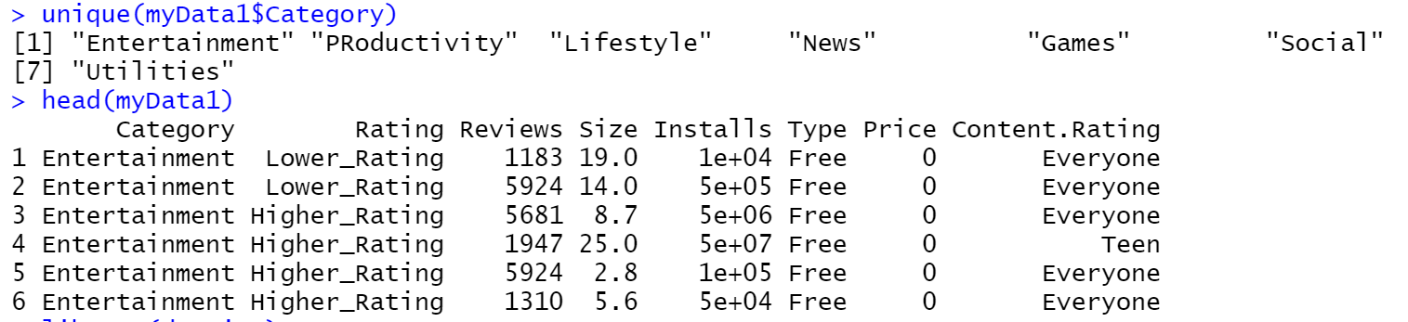
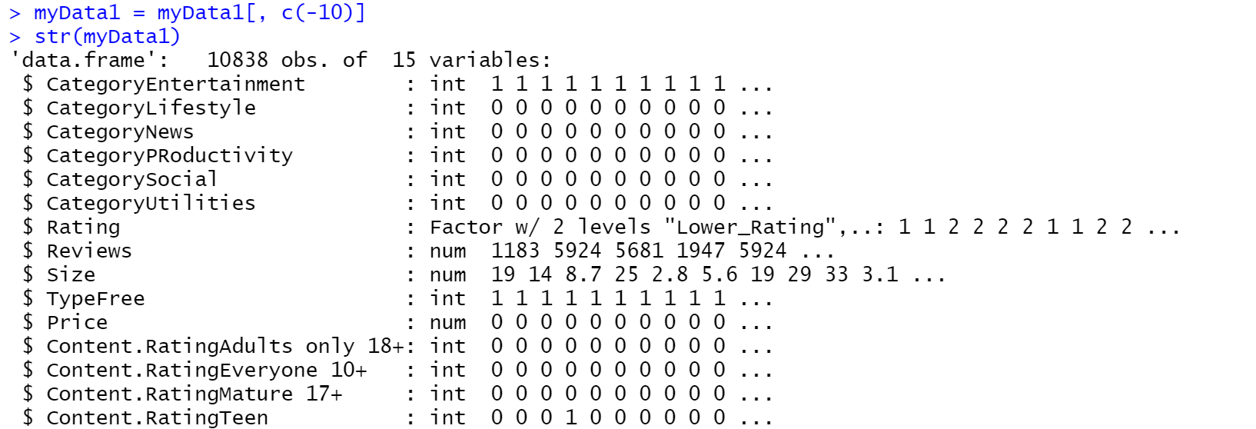
Data Preprocessing for Classification Models
Grouped Category column into 7 labels to ease down the task (as per Professor’s suggestion)
Dropped Installs column since it won’t be present when predicting rating at initial stage (Professor’s suggestion)

Slide 12
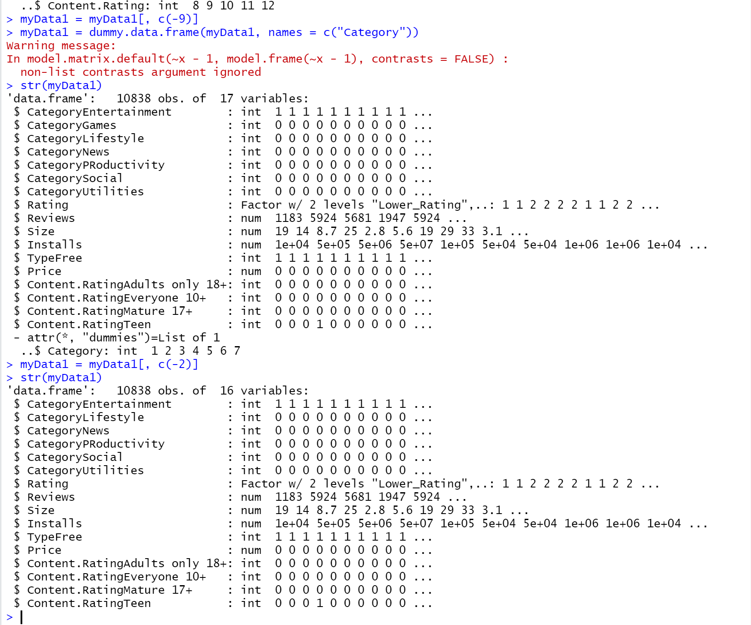
Data Preprocessing for Classification Models
Created N-1 Dummy variables for all the categorical variables while building Classification Model.
Converted “Rating” into categorical variable by splitting the data based on Median value.

Slide 13
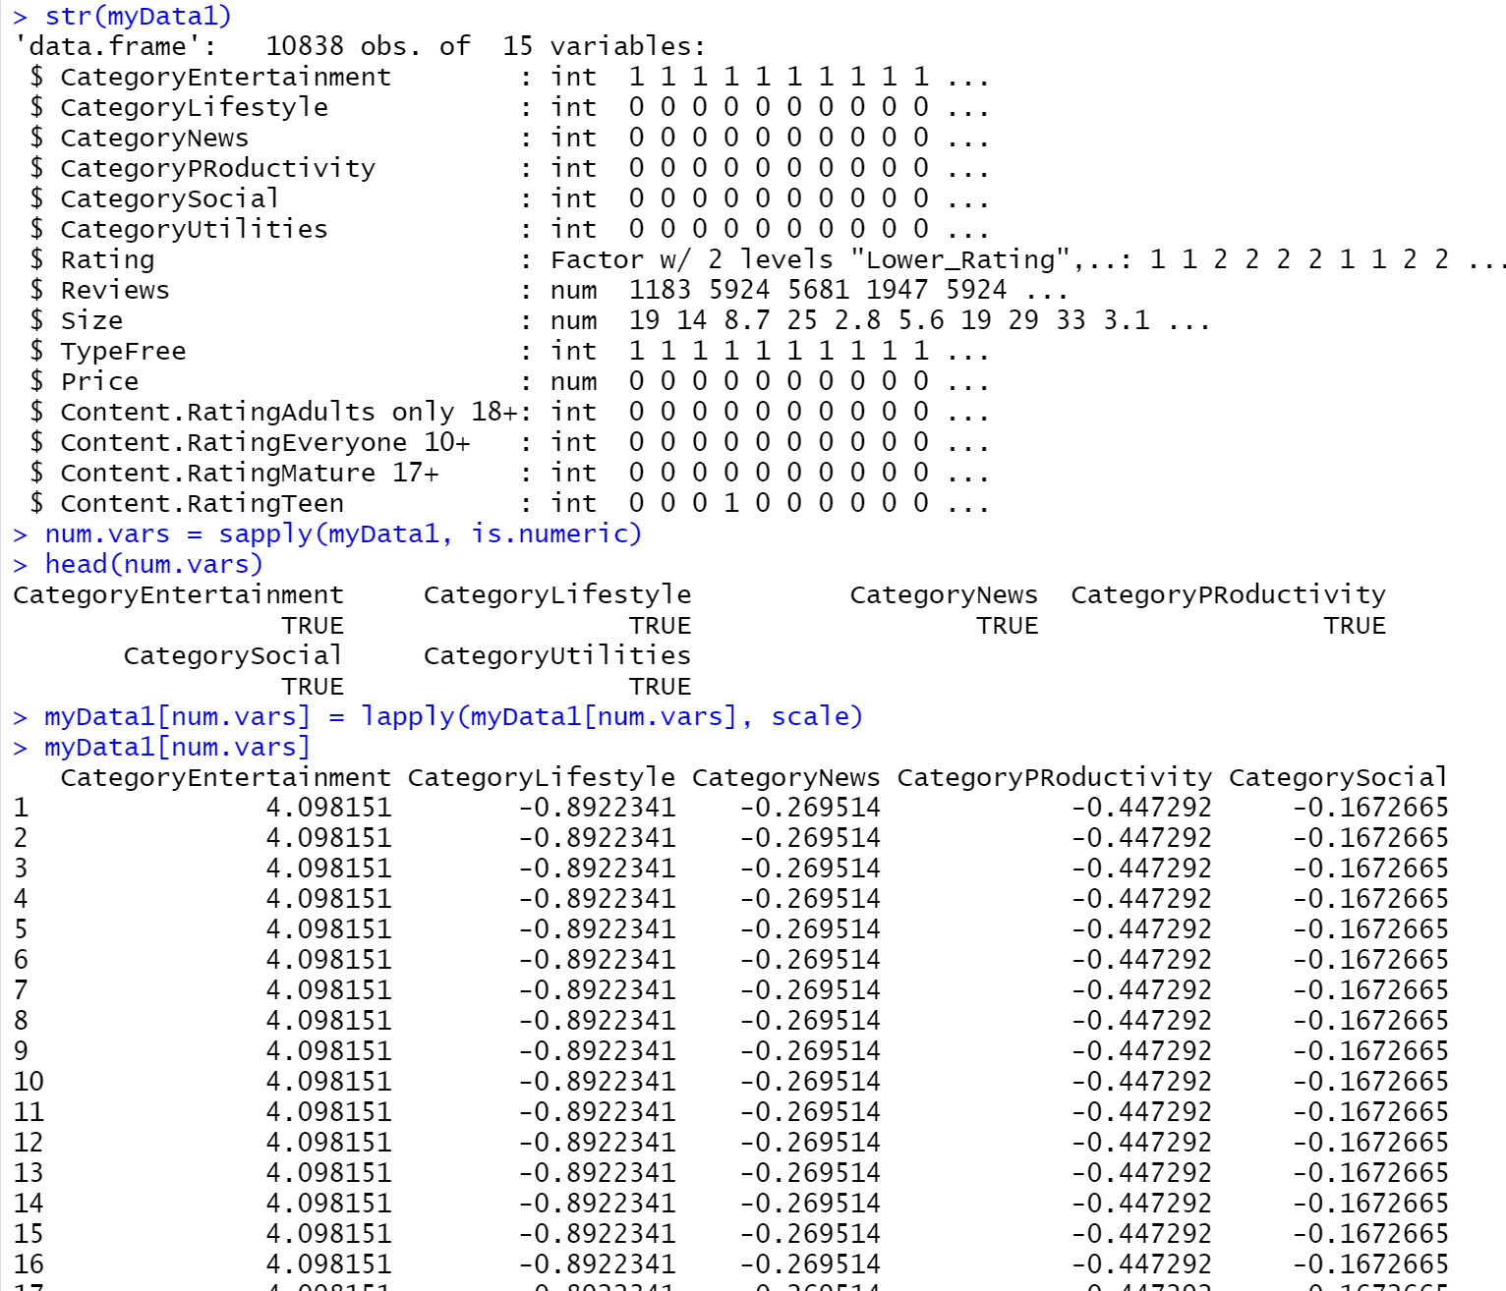
KNN Classification: Data Split
Used N-Fold Cross Validation because of small Dataset.

Slide 14
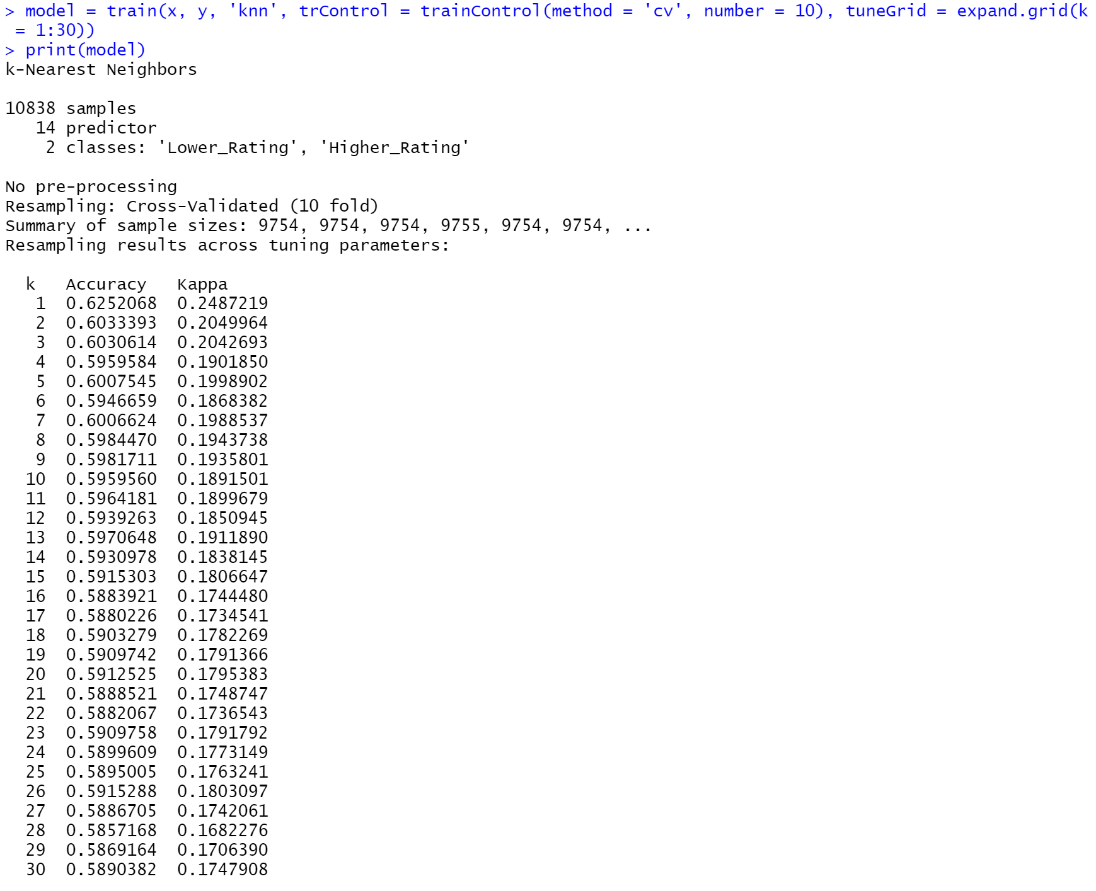
KNN Classification: Model Building
Built multiple KNN Classification models for K=1:30
Finally, we can conclude that KNN model is best at k = 1 with accuracy of 0.6252068 ~ 62.52%

Slide 15
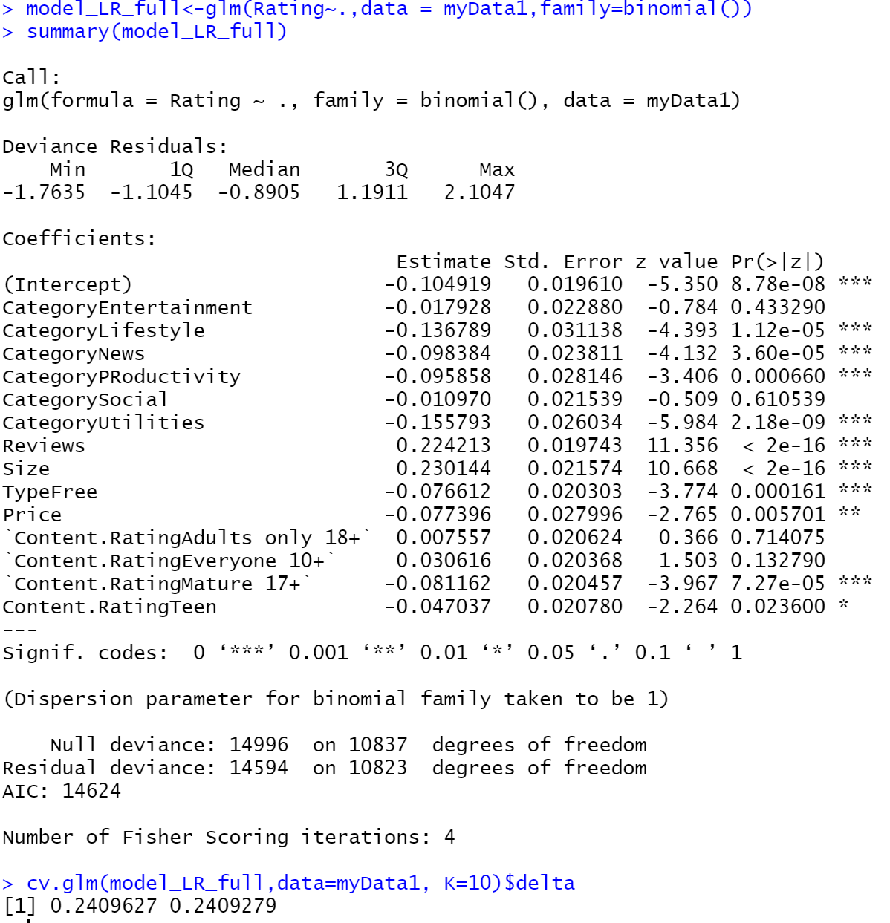
Logistic Regression: Full Model
Full Model AIC Value: -14624
Accuracy: - 75.88%

Slide 16
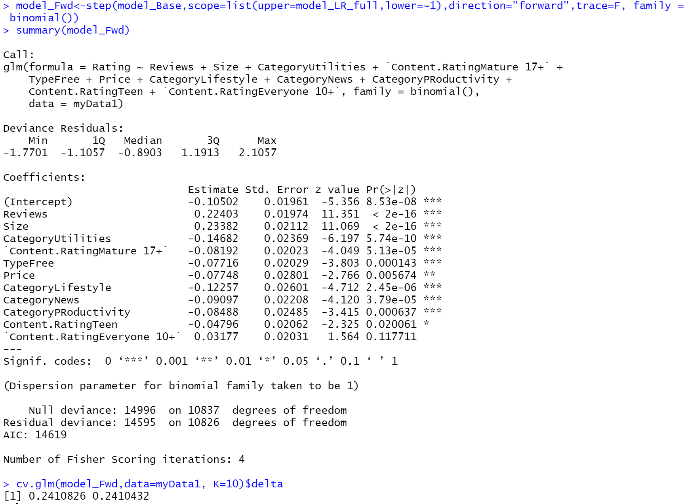
Logistic Regression: Forward model
Forward Model AIC Value: -14619
Accuracy: - 75.897%

Slide 17
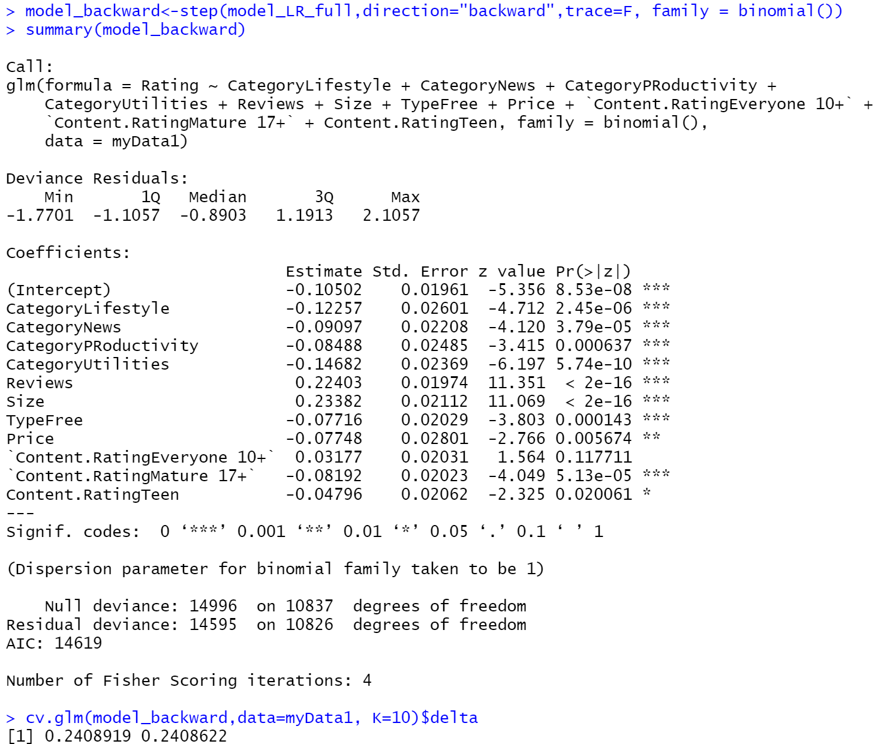
Logistic Regression: Backward model
Backward Model AIC Value: -14619
Accuracy: - 75.10%

Slide 18
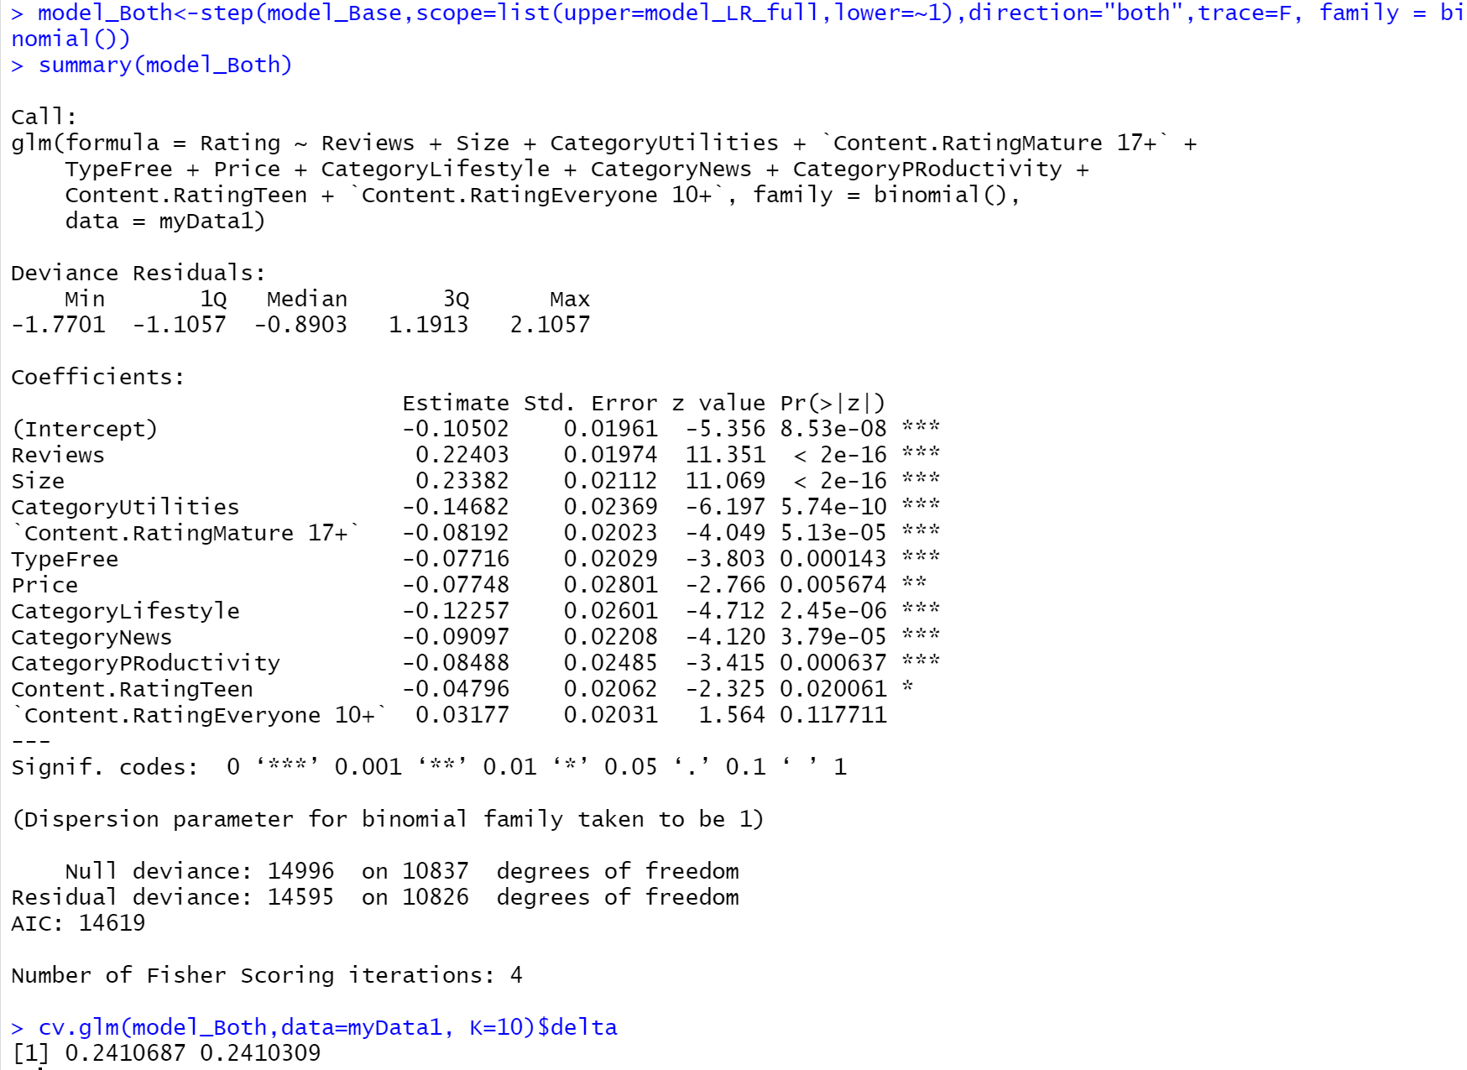
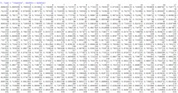

Logistic Regression: Both Model
Built Logistic Regression Full model on train data.
Both AIC Value: -14619
Accuracy: - 75.893%
Notes:
Need to add something.

Slide 19
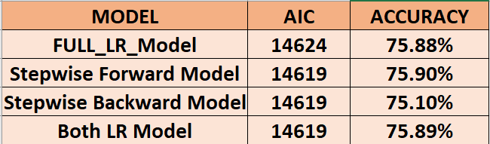
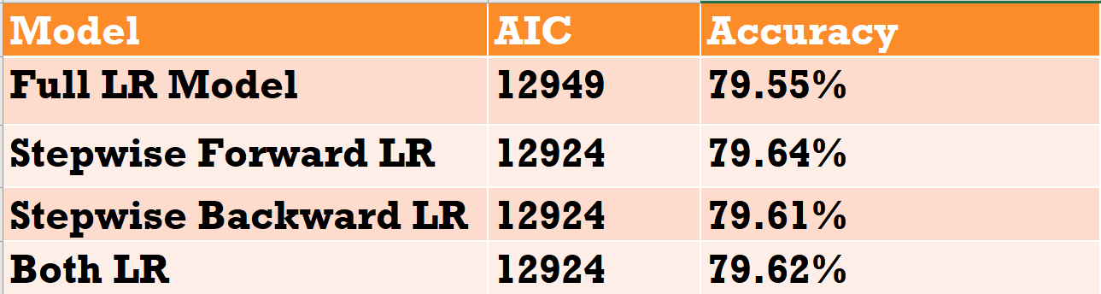
Logistic Regression: Best Model
Built Logistic Regression full, stepwise forward, backward & both models on data.
We can see that the Accuracy of the Stepwise Forward LR is the best. i.e 75.897% or 75.90%

Slide 20
Evaluation and Validation

Slide 21
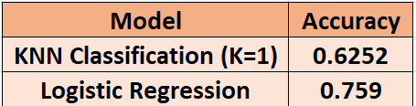
Evaluate Best Classification Model
We build two different classification models to predict the Rating.
Accuracies of both the models are as shown in the table.
Finally, we consider the Forward Logistic Regression model the best, as to make predictions with the highest accuracy, i.e 0.7589718 ~ 75.897%

Slide 22

Results and Conclusion
The ulterior motive of this project is to help the developers to predict the performance of an application based on Rating(higher or lower) on Google Play Store. This will help in saving tons of money, time and labour.
The following hypothesis were proven:
We cannot predict whether a specific Category of application will do good in market based on other category
Average rating of applications with different categories will be different.
We have built multiple classification models to predict the Rating, (which is our dependent variable) and found that Logistic Regression model is predicting with the highest accuracy of 75.897%, using N-Fold Cross Validation.

Slide 23
Thank You..!!

